Slide 1

17BIT0368
Capstone Rev-1
Offcampus+mini-project

Slide 2
Where do I work at?

Slide 3


Slide 4
My First Project Assigned(During Capstone Project)
flow.twimbit.ai

Slide 5
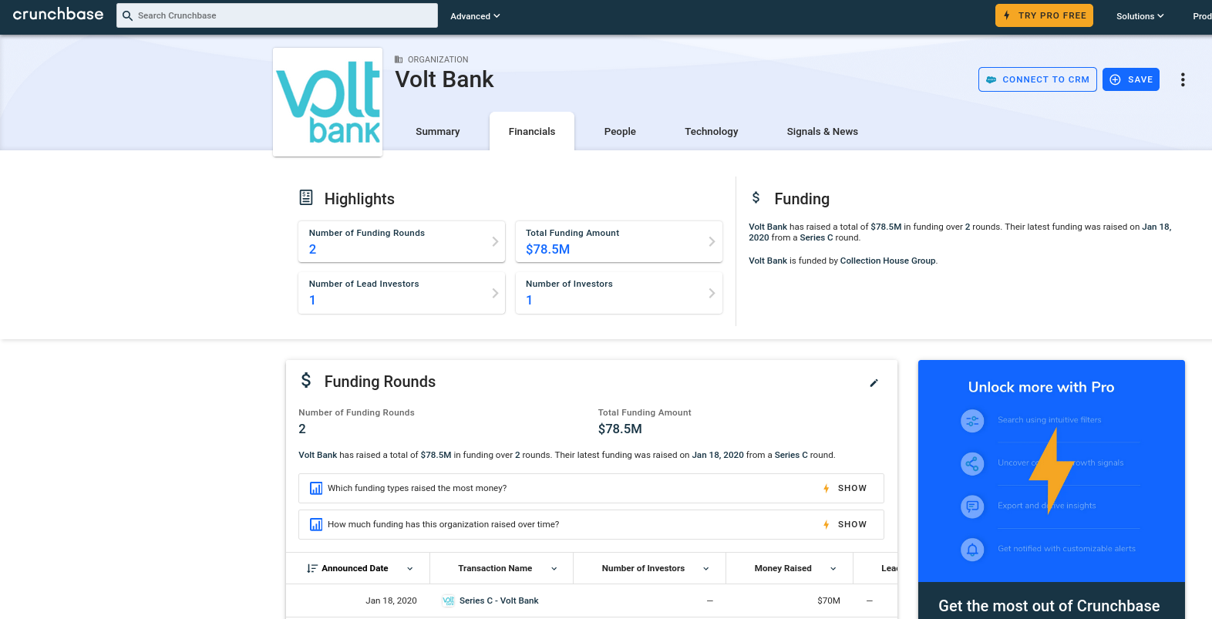

Slide 6
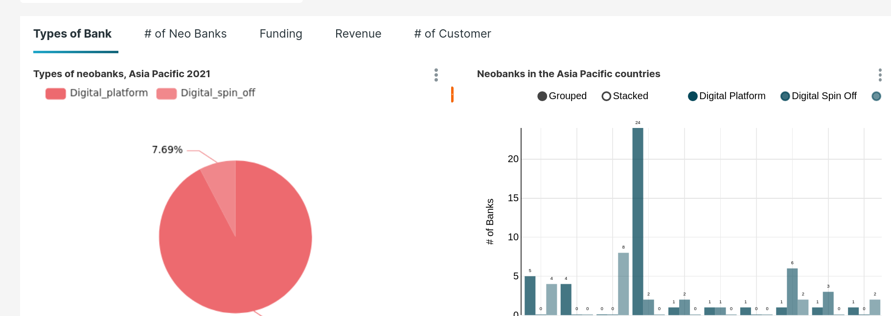
Hence making
FLOW.TWIMBIT.AI

Slide 7
Capstone Project Assigned -
Dash.Twimbit.Ai

Slide 8

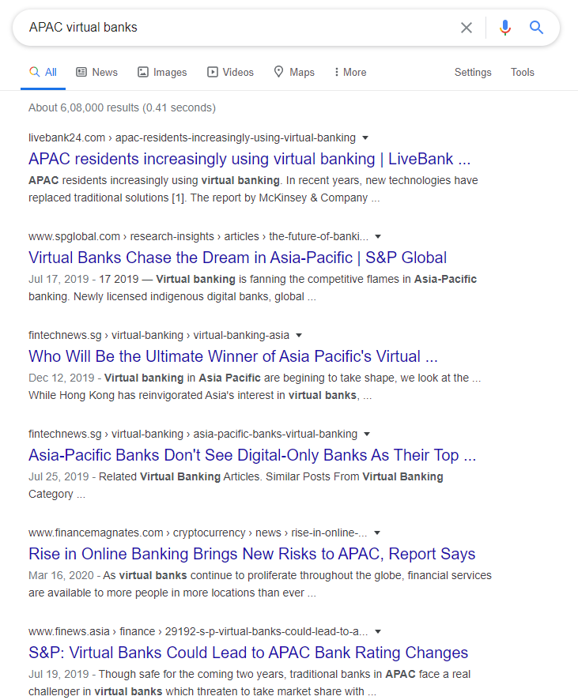
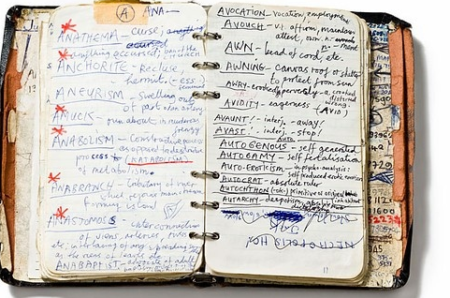
Problem
Analysing vast amount of data
Find true fact from the information
Context loss in heap of data
Time consuming and labour intensive process

Slide 9

Twimintel.ai
It’s a system of ML and AI tools that process vast amount of textual and statistical information to generate them as simplifies context based intelligence

Slide 10
Process

Slide 11

Log the information
Collect all the relevant links and add it to our query base
Research analyst open all relevant tabs in there browser related to the query
Using a extension, they collect and save all those tabs to our system with keywords and problem statement
Tabs
keywords
Problem Statement
Logged to batch

Slide 12
Analyse the Links
text
Embedding
vectors
models
html
images
Crawl
Parse
Store

Slide 13
Improving the system
Expand the corpus
Improve the models
Feedback 1 model
Add new relevant links to corpus
Better model
Discard non relevant data
New Query Data
Feedback 2 model

Slide 14
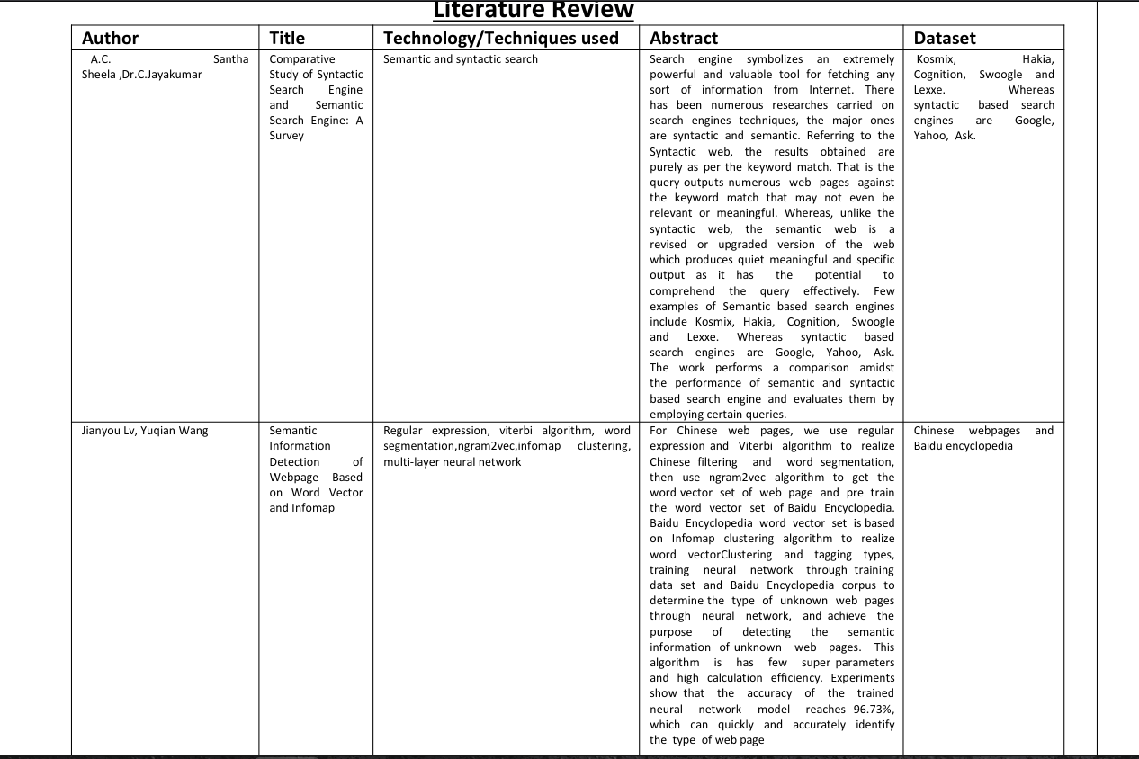
Literature Survey

Slide 15
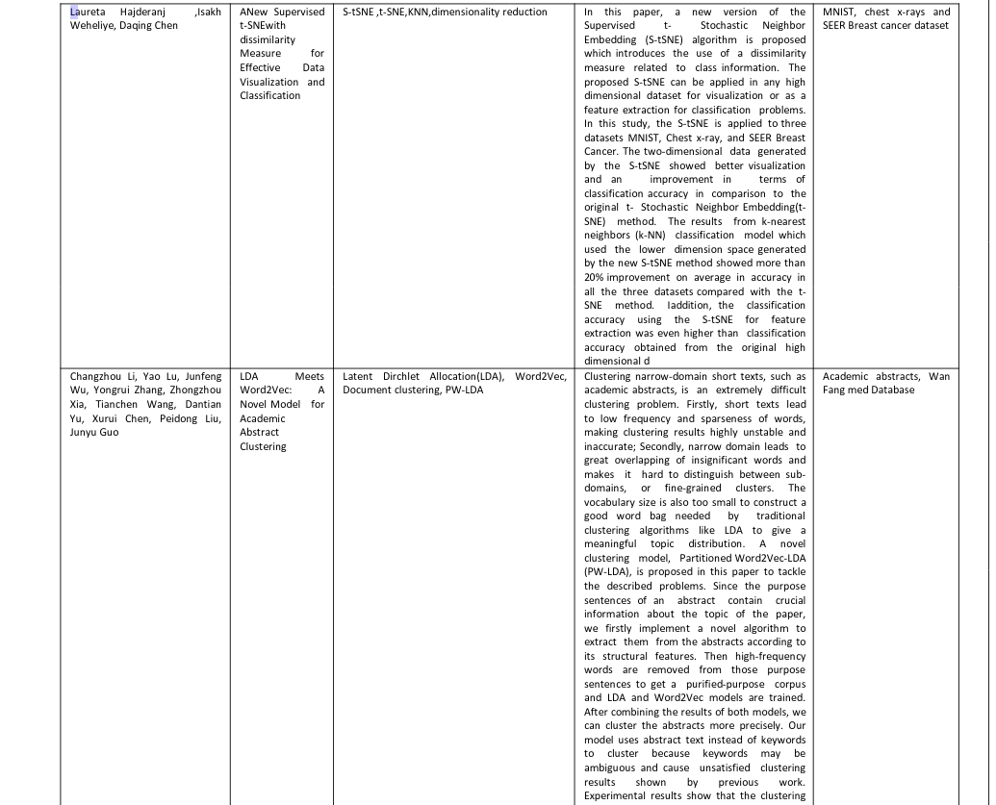
Literature Survey

Slide 16
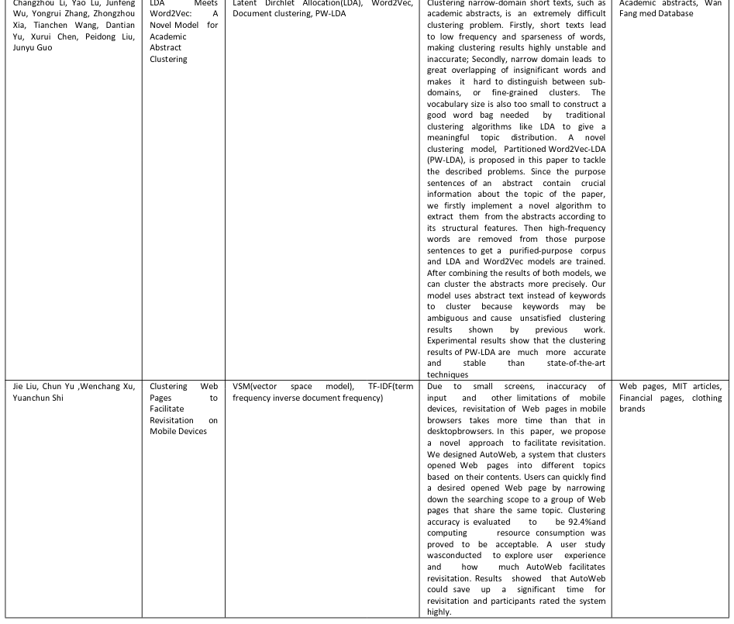
Literature Survey

Slide 17
Implementation- 60%
Created Universal Scraper
Word to Vectoriser
Keyword Ranker

Slide 18
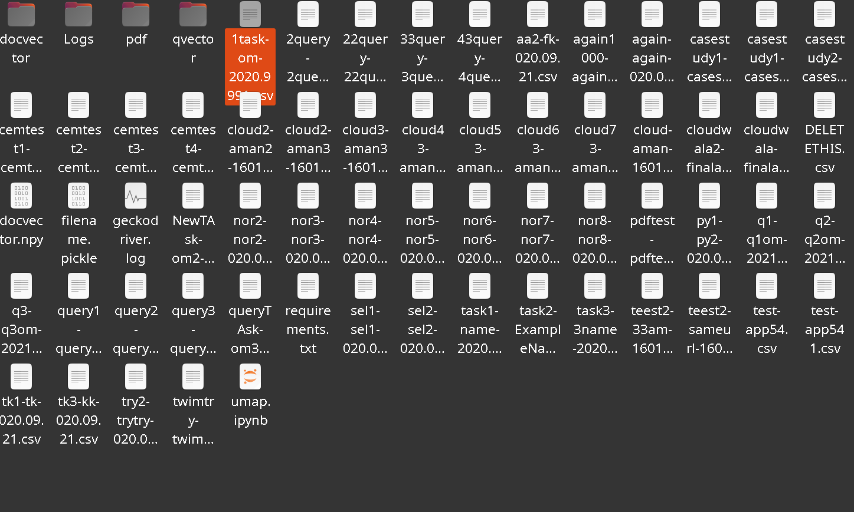
Process

Slide 19
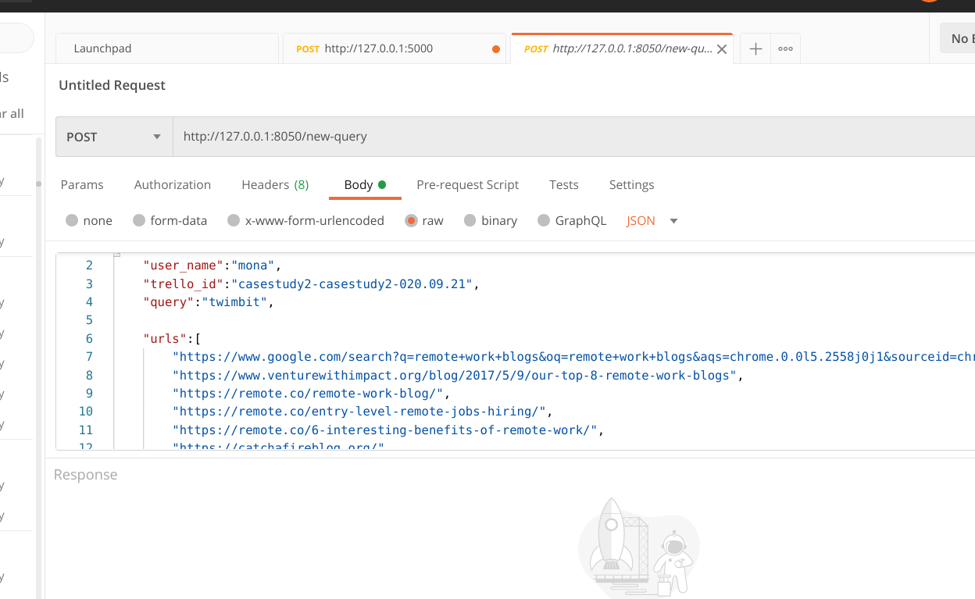

Slide 20
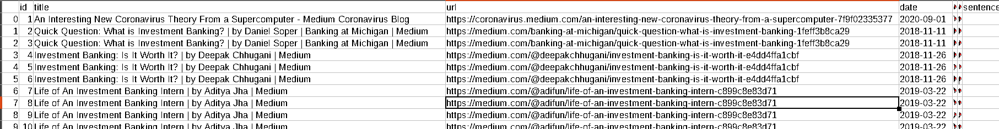
Datapoints consists of , Id,title,url,date,timestamp,positive,negative,neutral sentiments…… and many more Datapoints which I am not allowed to share due to privacy policy

Slide 21
Rainfall near Vellore EDA and Prediction
MINI-Project Under Guide Kathiravan sir

Slide 22
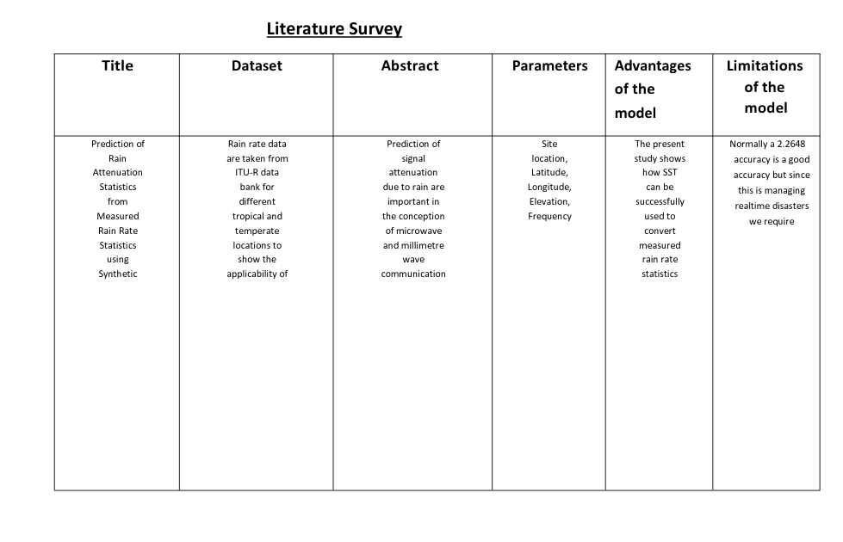

Slide 23
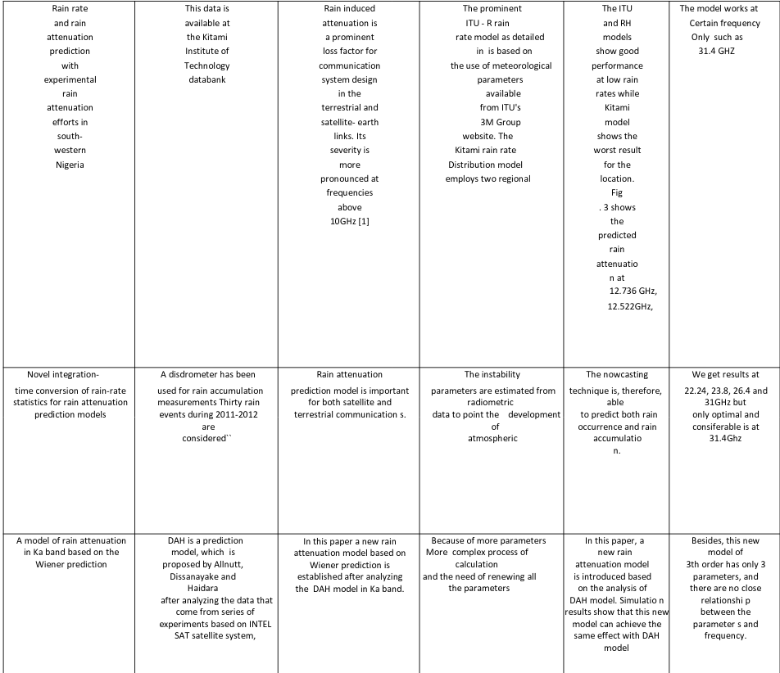

Slide 24
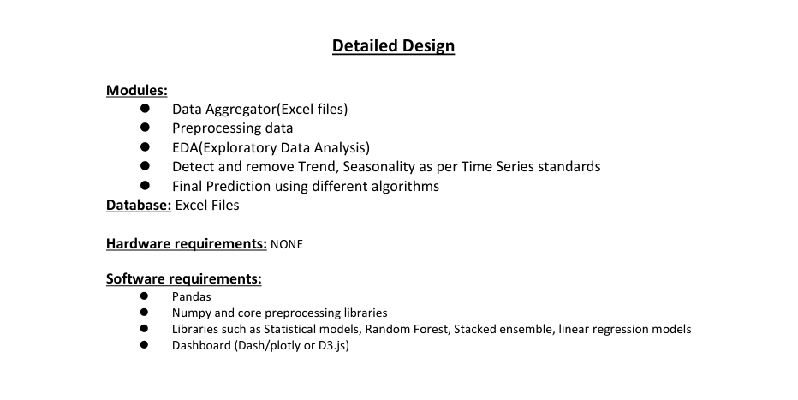

Slide 25
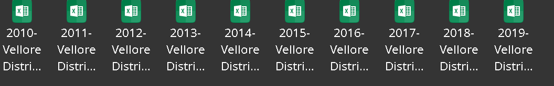
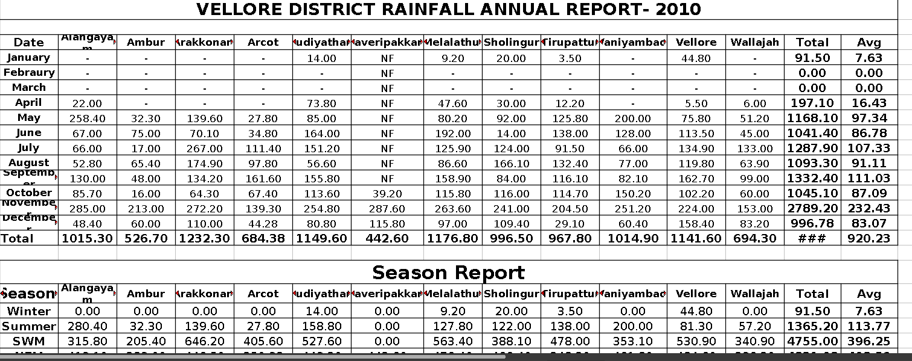
Dirty and Raw Data

